Slide 1

Pacific Lamprey Translocation
Confederated Tribes of Grand Ronde
    Bryan Fendall
    Aquatic Biologist

Slide 2
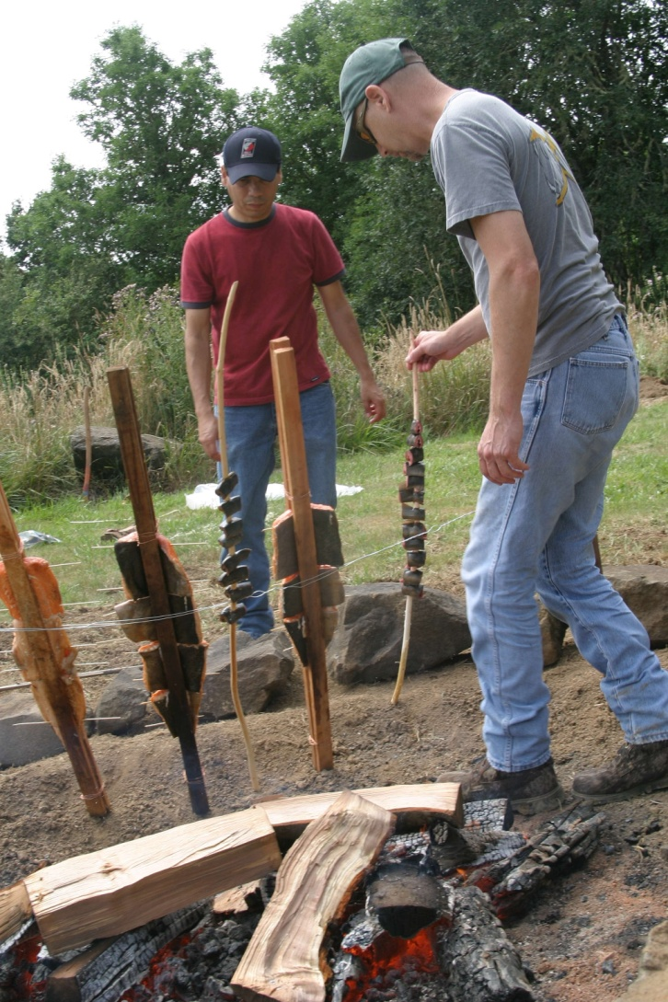
Pacific Lamprey Significance
Confederated Tribes
of Grand Ronde
    Spiritual
    Medicinal
    Subsistence

Slide 3
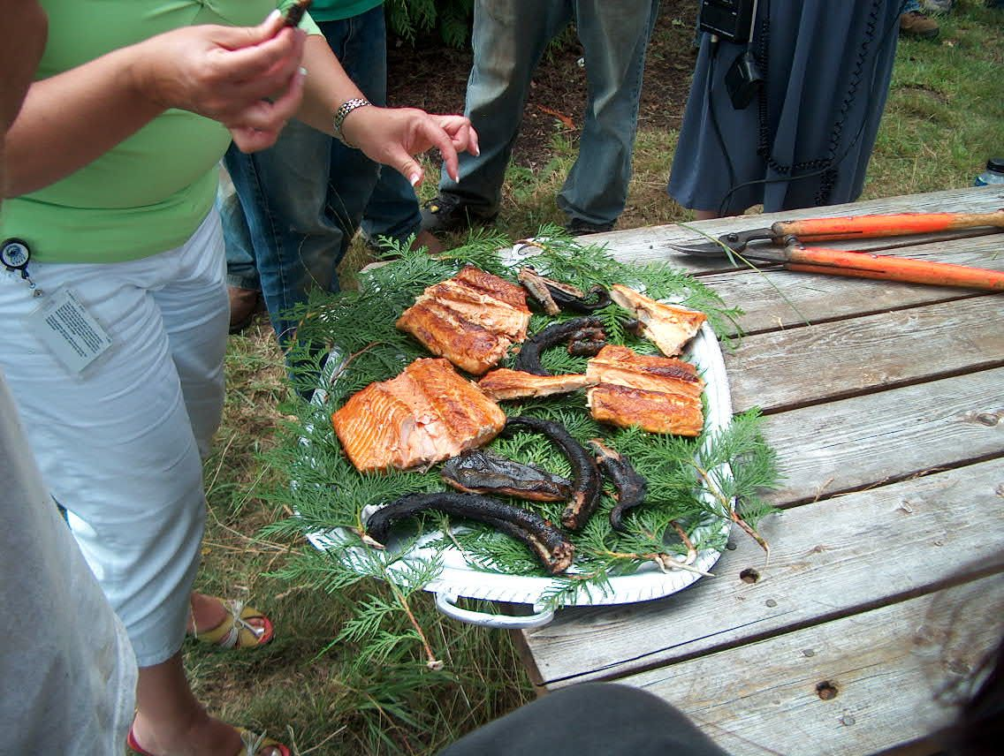
Pacific Lamprey Significance
Confederated Tribes
of Grand Ronde
    Trade & Gift Giving
    Way of Life

Slide 4
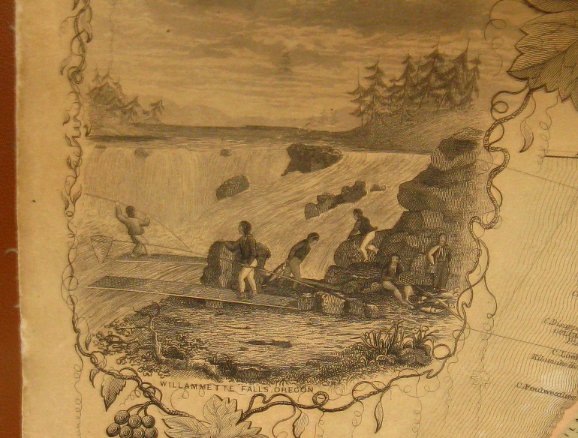
Pacific Lamprey Status
Confederated Tribes
of Grand Ronde
Historic
  Willamette Basin
Current
  In Decline

Slide 5
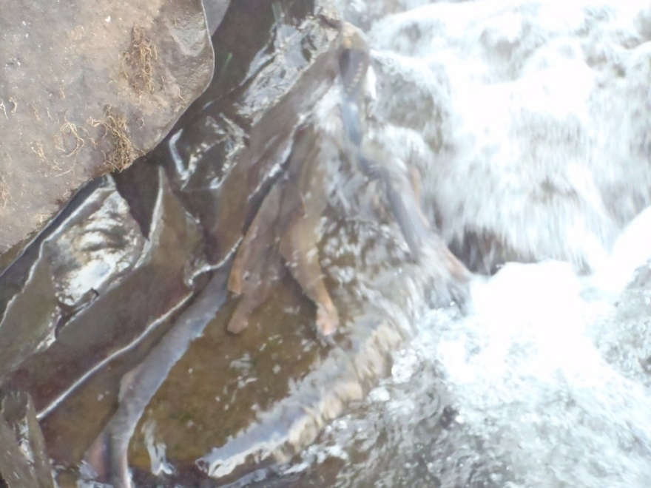
Pacific Lamprey Significance
Confederated Tribes
of Grand Ronde
To better understand the decline, Grand Ronde has taken an active role in Pacific lamprey research

Slide 6
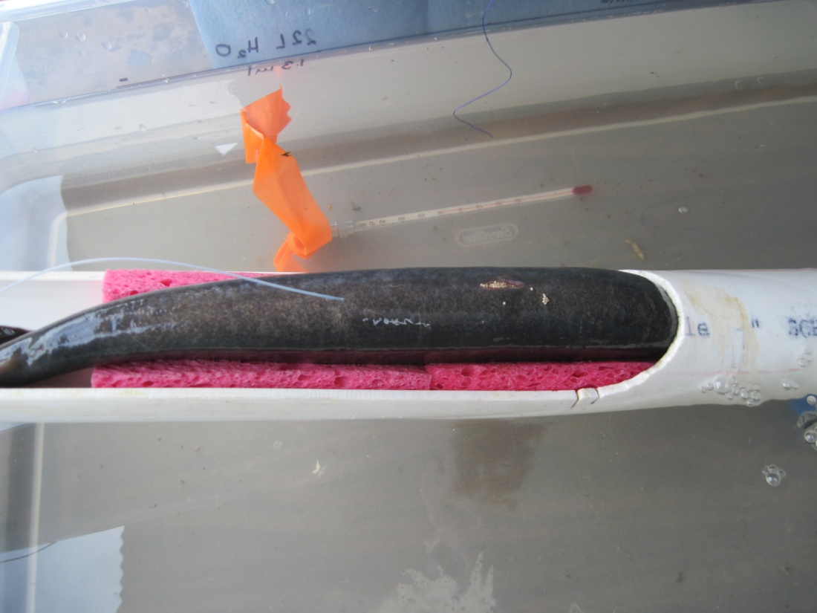
Pacific Lamprey Research
Confederated Tribes
of Grand Ronde
Migration behavior study
  2008 - 2012
  Radio-telemetry
  Willamette Falls
Notes:
Cut or move

Slide 7
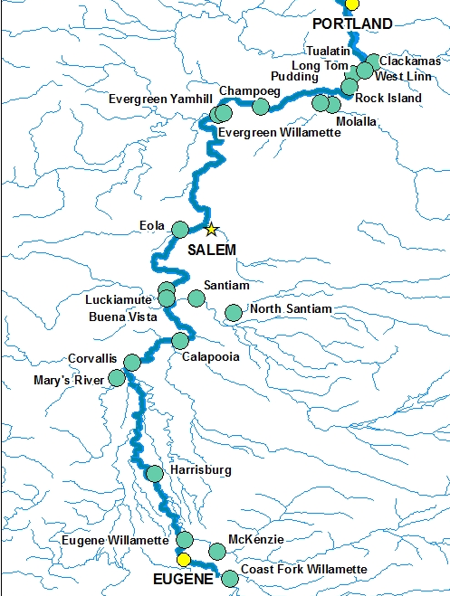
Pacific Lamprey Research
Confederated Tribes
of Grand Ronde
Location of 22 fixed telemetry receiver sites
Mainstem and tributaries
Notes:
Old Project short description

Slide 8
Pacific Lamprey Research
Confederated Tribes
of Grand Ronde
Data
  Relative use patterns of spawning tributaries
  Migratory and tributary selection behaviors were variable
  What environmental factors drive selection
  Explore adult reintroduction
    Determine if juvenile pheromones influence adult tributary selection

Slide 9
Pacific Lamprey Translocation
Confederated Tribes
of Grand Ronde
Translocation Pilot Study
  Reintroduce adult lamprey to historic spawning habitat
  Pacific lamprey
    Ascend high gradients
    Observed in high gradient tributaries, successfully locating suitable spawning habitats
  Fall Creek
    Telemetry data detected adults entering Coast Fork, similarly high in system
    Streams known to sustain lamprey spawning have common habitat attributes observed above dam

Slide 10
Pacific Lamprey Translocation
Confederated Tribes
of Grand Ronde
Fall Creek
  Adult passage naturally occurs in Middle Fork
    Aerial tracking detected adults close to both Fall Creek & Dexter Dams (Clemens et al. 2012)
    Ammocoetes present in Middle Fork below Fall Creek
  Reservoir drains to run of the river
    Juvenile out-migration is feasible

Slide 11
Pacific Lamprey Translocation
Confederated Tribes
of Grand Ronde
Fall Creek
  Proximity to Middle Fork
    No known lamprey passage issues
  LPS could be feasible at potentially low cost
    Lamprey ramp
    Truck and haul

Slide 12
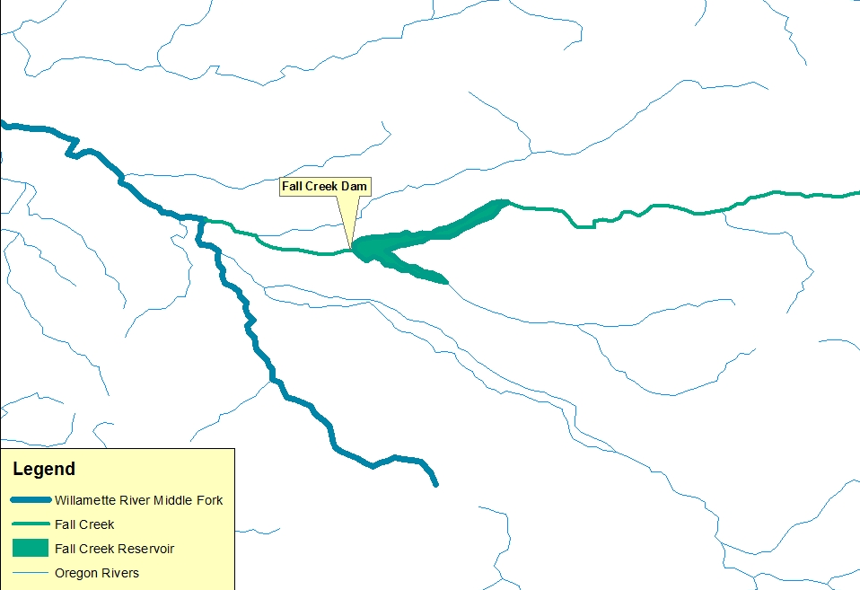
Pacific Lamprey Translocation
Confederated Tribes
of Grand Ronde

Slide 13
Pacific Lamprey Translocation
Confederated Tribes
of Grand Ronde
Translocation Project
  Capture adults from Willamette Falls
  Transport to Fall Creek via truck
  Release
    Successful Pacific lamprey reproduction above dam
    Determine if juvenile pheromone presence will cause adults to approach and attempt passage of dam

Slide 14
Pacific Lamprey Translocation
Confederated Tribes
of Grand Ronde
Considerations
  Brook known to exist both above/below
  Pacific likely to exist below /not above
  Pacific ammocoete surveys above/below

Slide 15
Pacific Lamprey Translocation
Confederated Tribes
of Grand Ronde
Shocking Results
Sampled 8 Sites
  7 Above
  1 Below
  Above 578 Brook 0 Pacific
  Below 0 Brook 23 Pacific

Slide 16
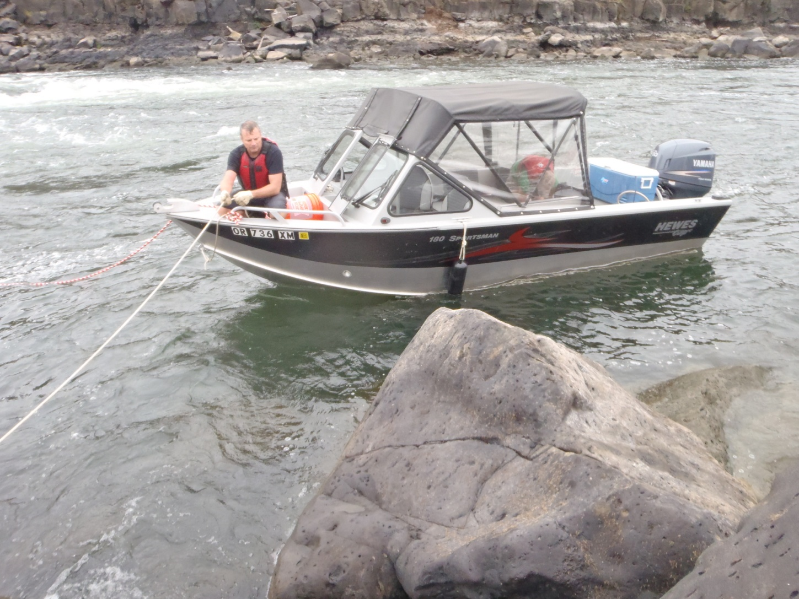
Pacific Lamprey Translocation
Confederated Tribes
of Grand Ronde
Accessing Falls to
collect adult lamprey

Slide 17
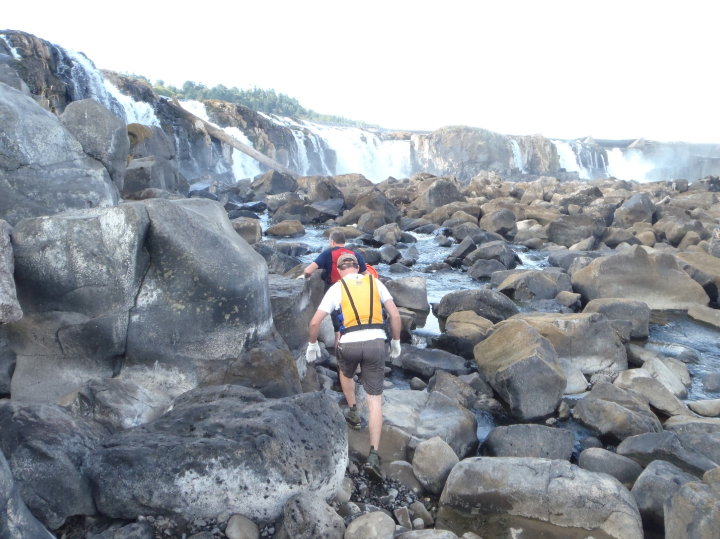
Pacific Lamprey Translocation
Confederated Tribes
of Grand Ronde
Accessing Falls to
collect adult lamprey

Slide 18
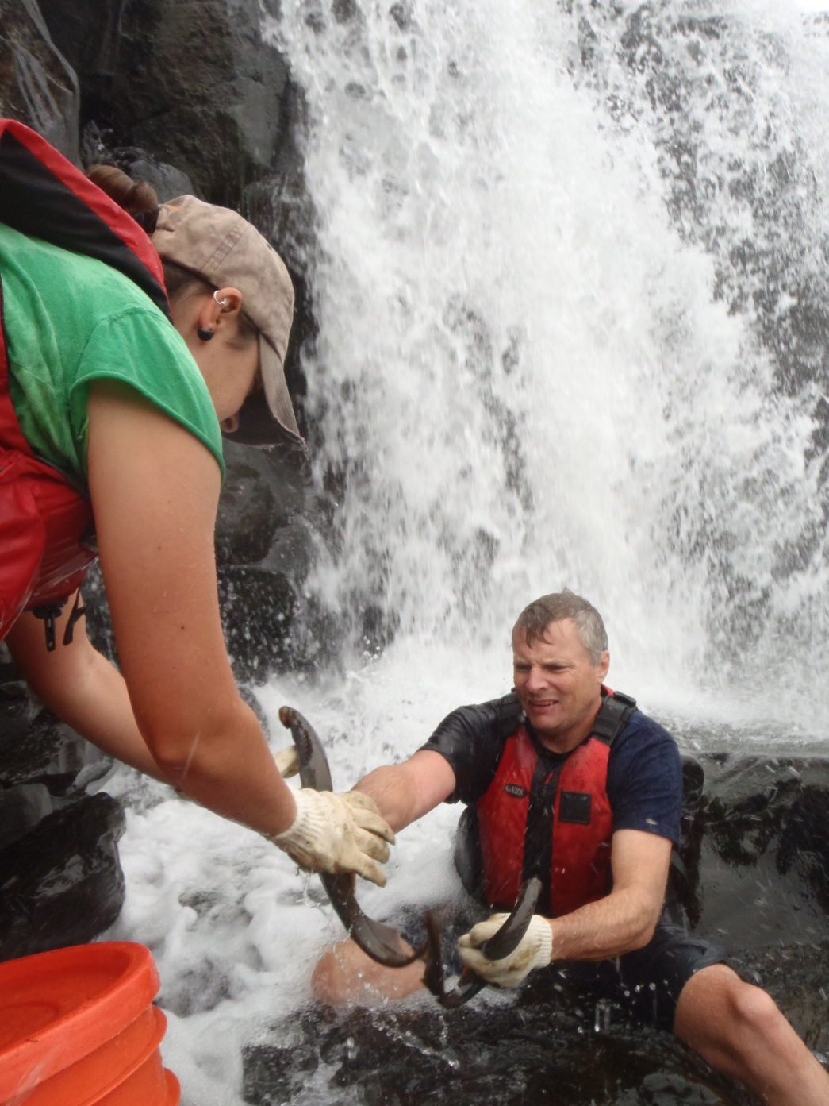
Pacific Lamprey Translocation
Confederated Tribes
of Grand Ronde
Capturing lamprey from Willamette Falls

Slide 19
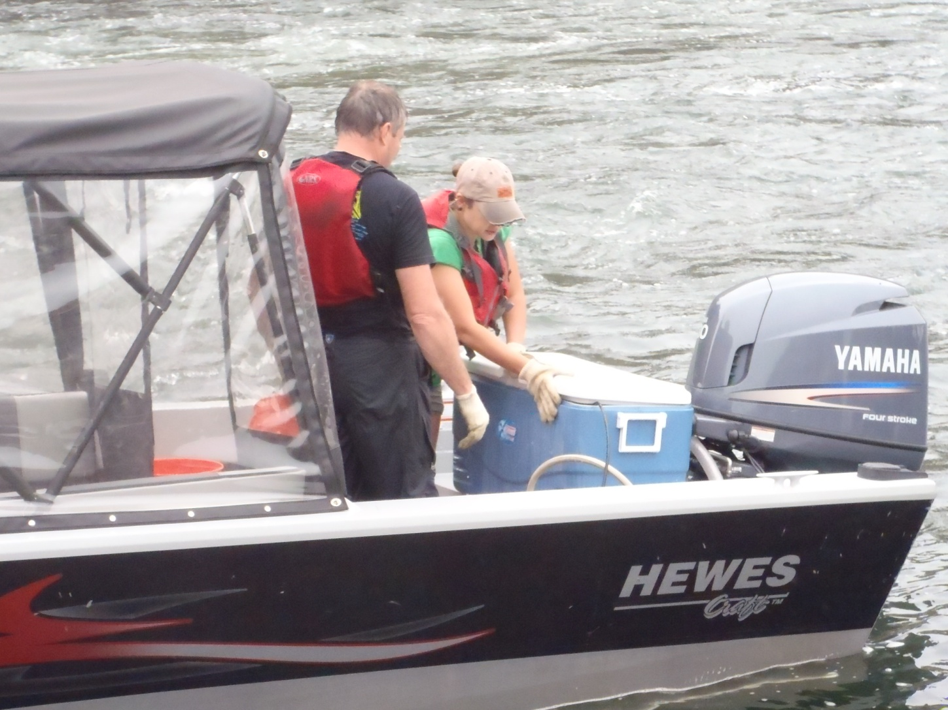
Pacific Lamprey Translocation
Confederated Tribes
of Grand Ronde
Live well transport
from Falls to truck

Slide 20
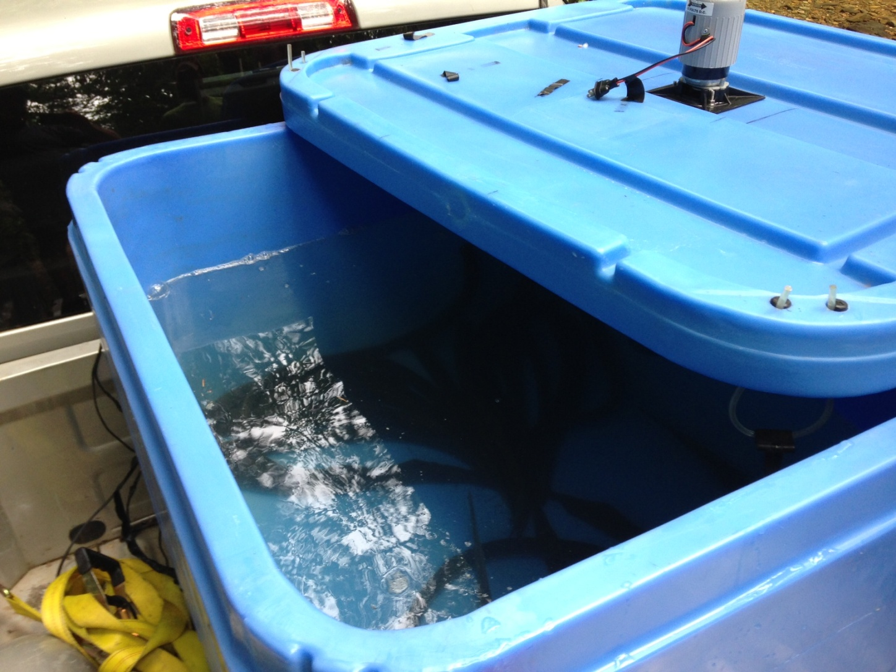
Pacific Lamprey Translocation
Confederated Tribes
of Grand Ronde
Insulated tote with agitator

Slide 21
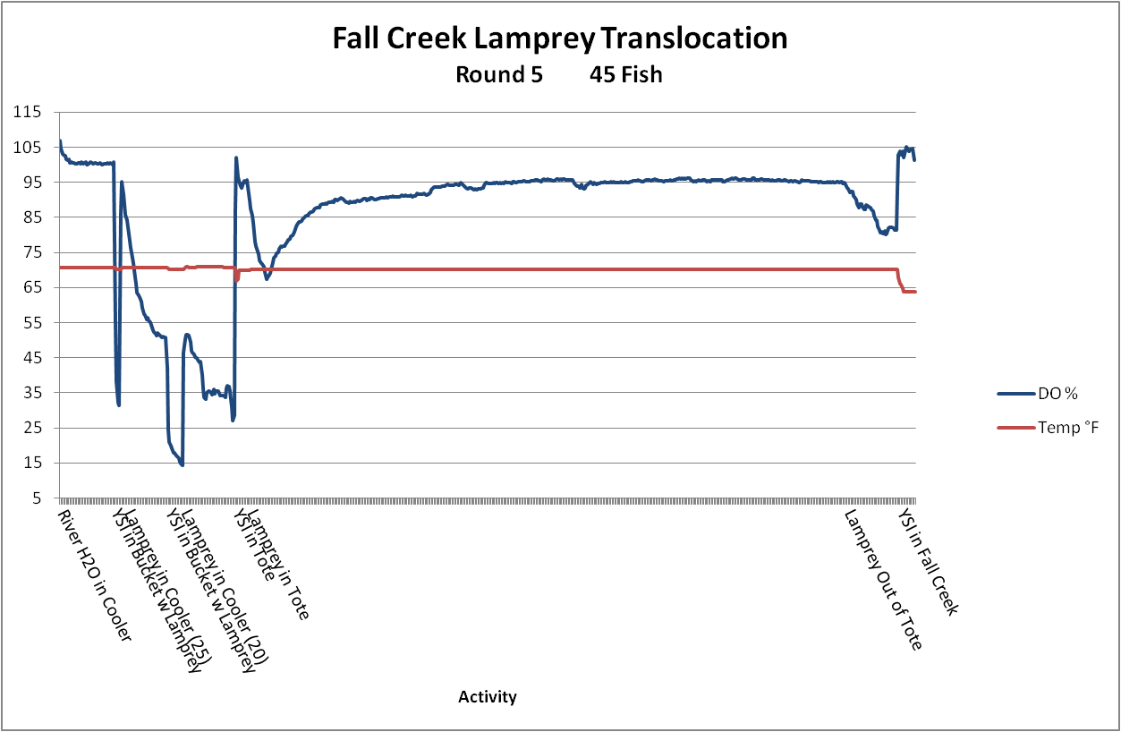
Pacific Lamprey Translocation
Confederated Tribes
of Grand Ronde

Slide 22
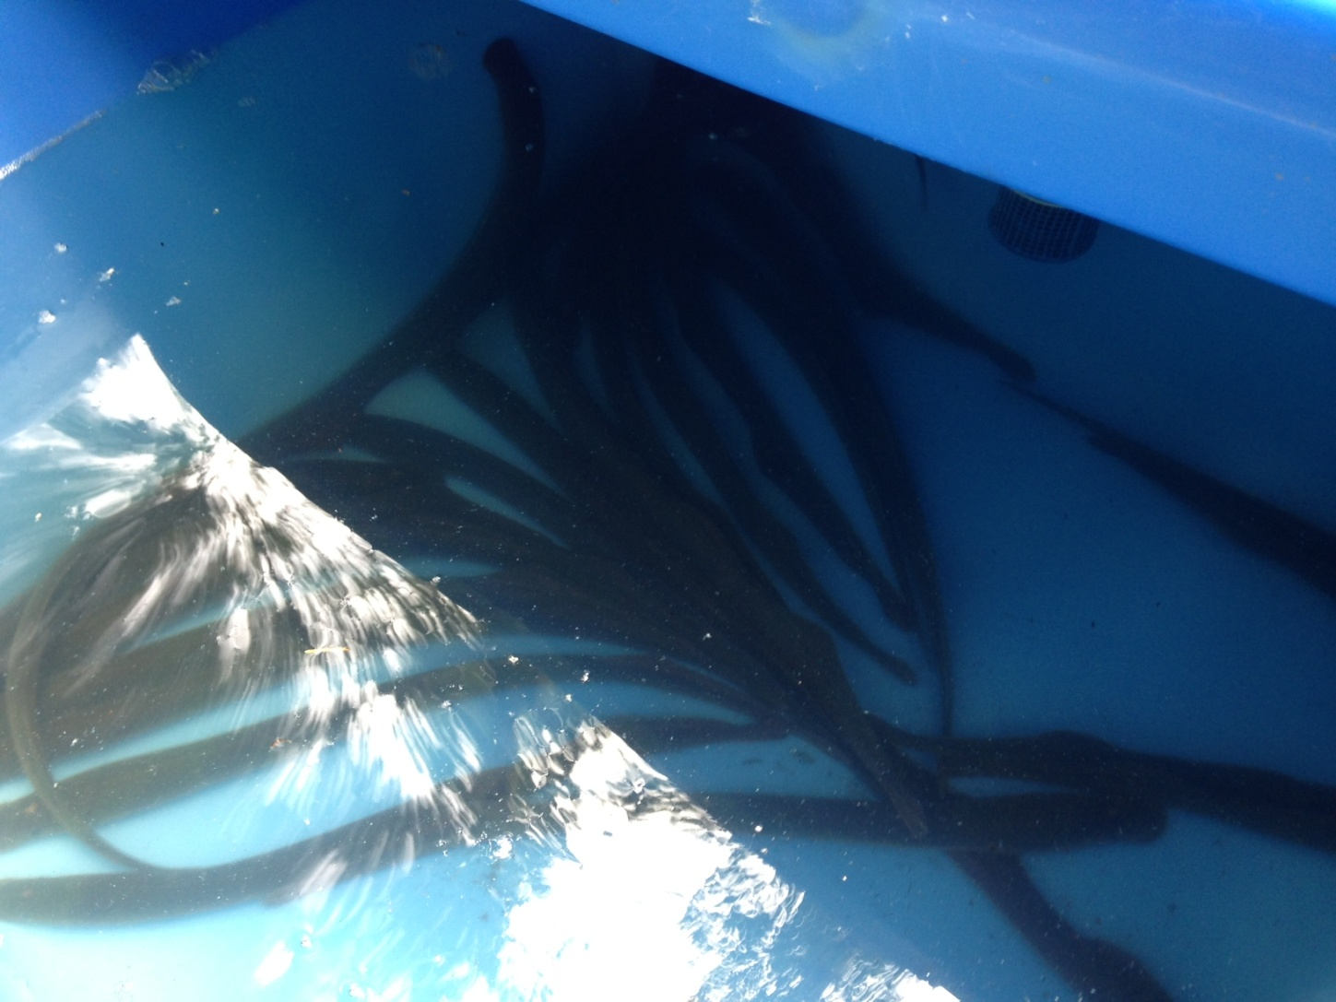
Pacific Lamprey Translocation
Confederated Tribes
of Grand Ronde
Adult Pacific lamprey - first arrival to Fall Creek

Slide 23
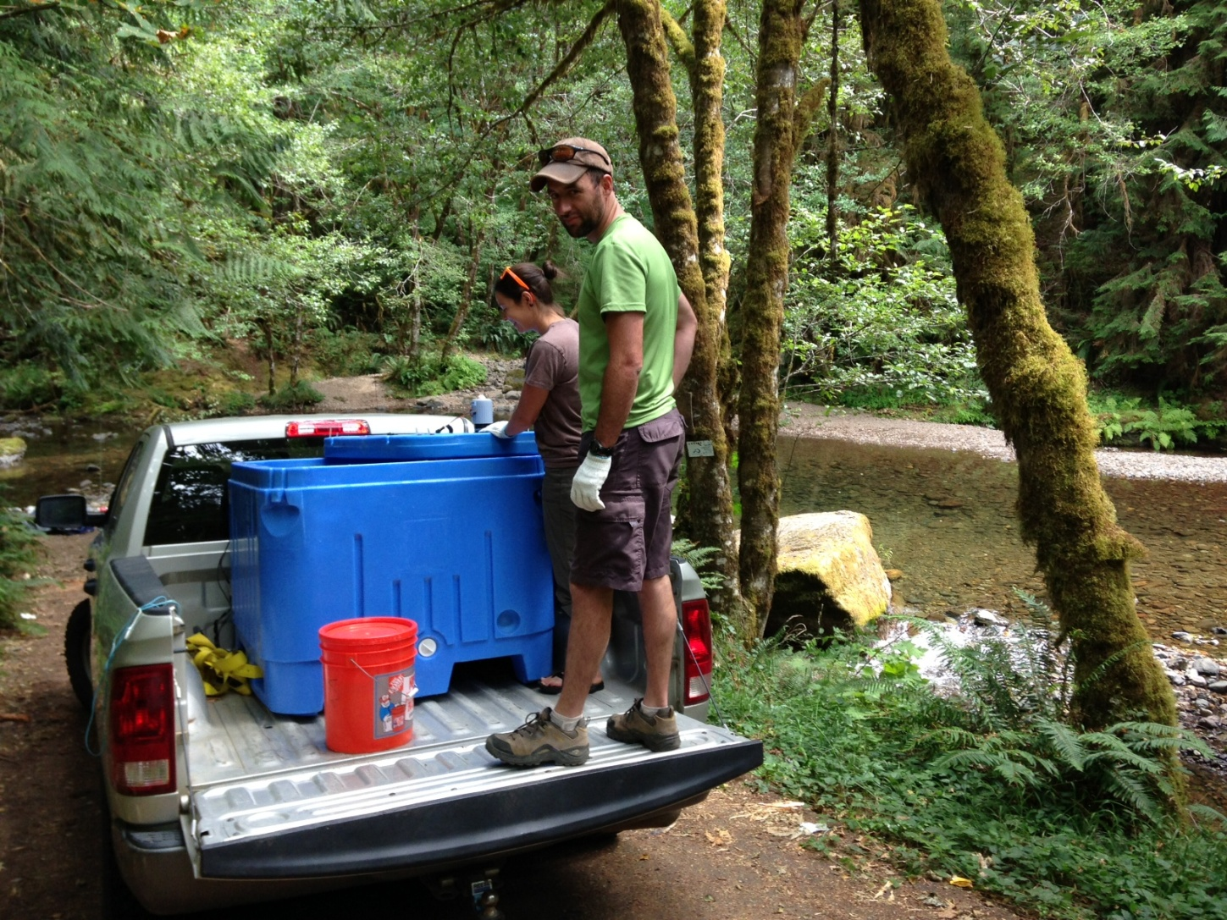
Pacific Lamprey Translocation
Confederated Tribes
of Grand Ronde
Fall Creek initial drop site (2013)

Slide 24
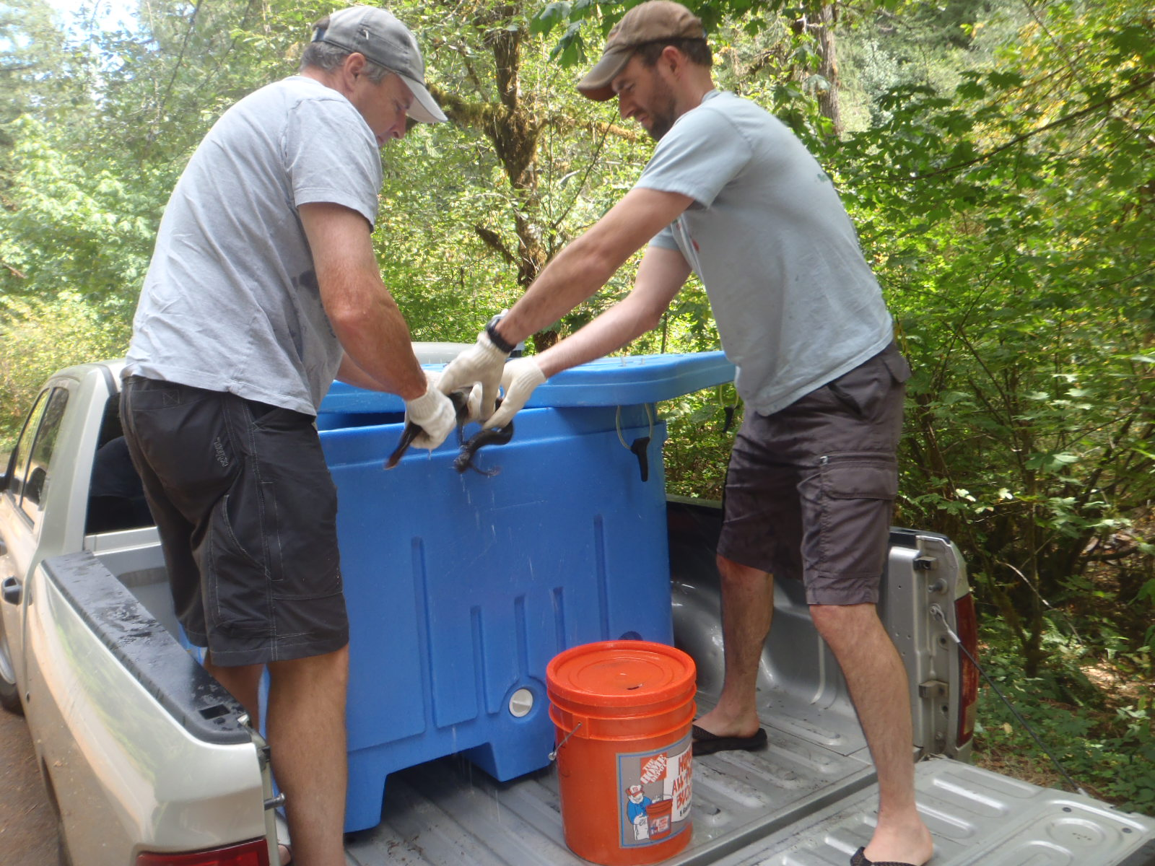
Pacific Lamprey Translocation
Confederated Tribes
of Grand Ronde
Fall Creek second drop site

Slide 25
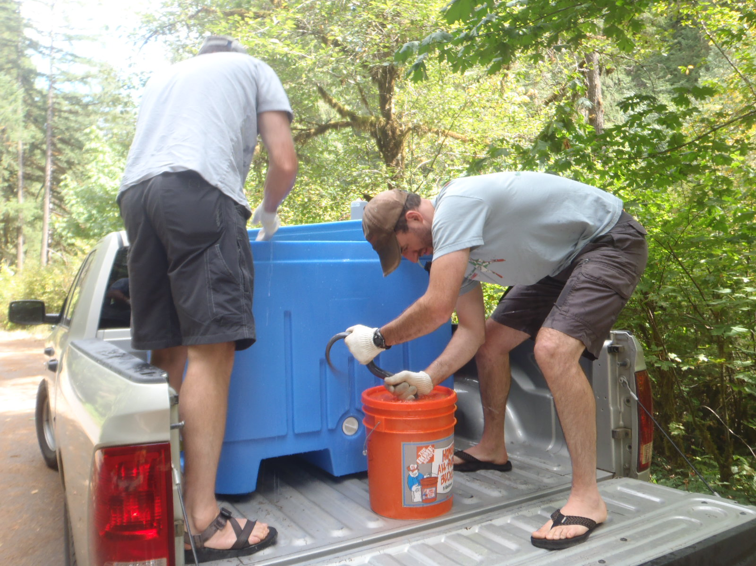
Pacific Lamprey Translocation
Confederated Tribes
of Grand Ronde
Fall Creek second drop site

Slide 26
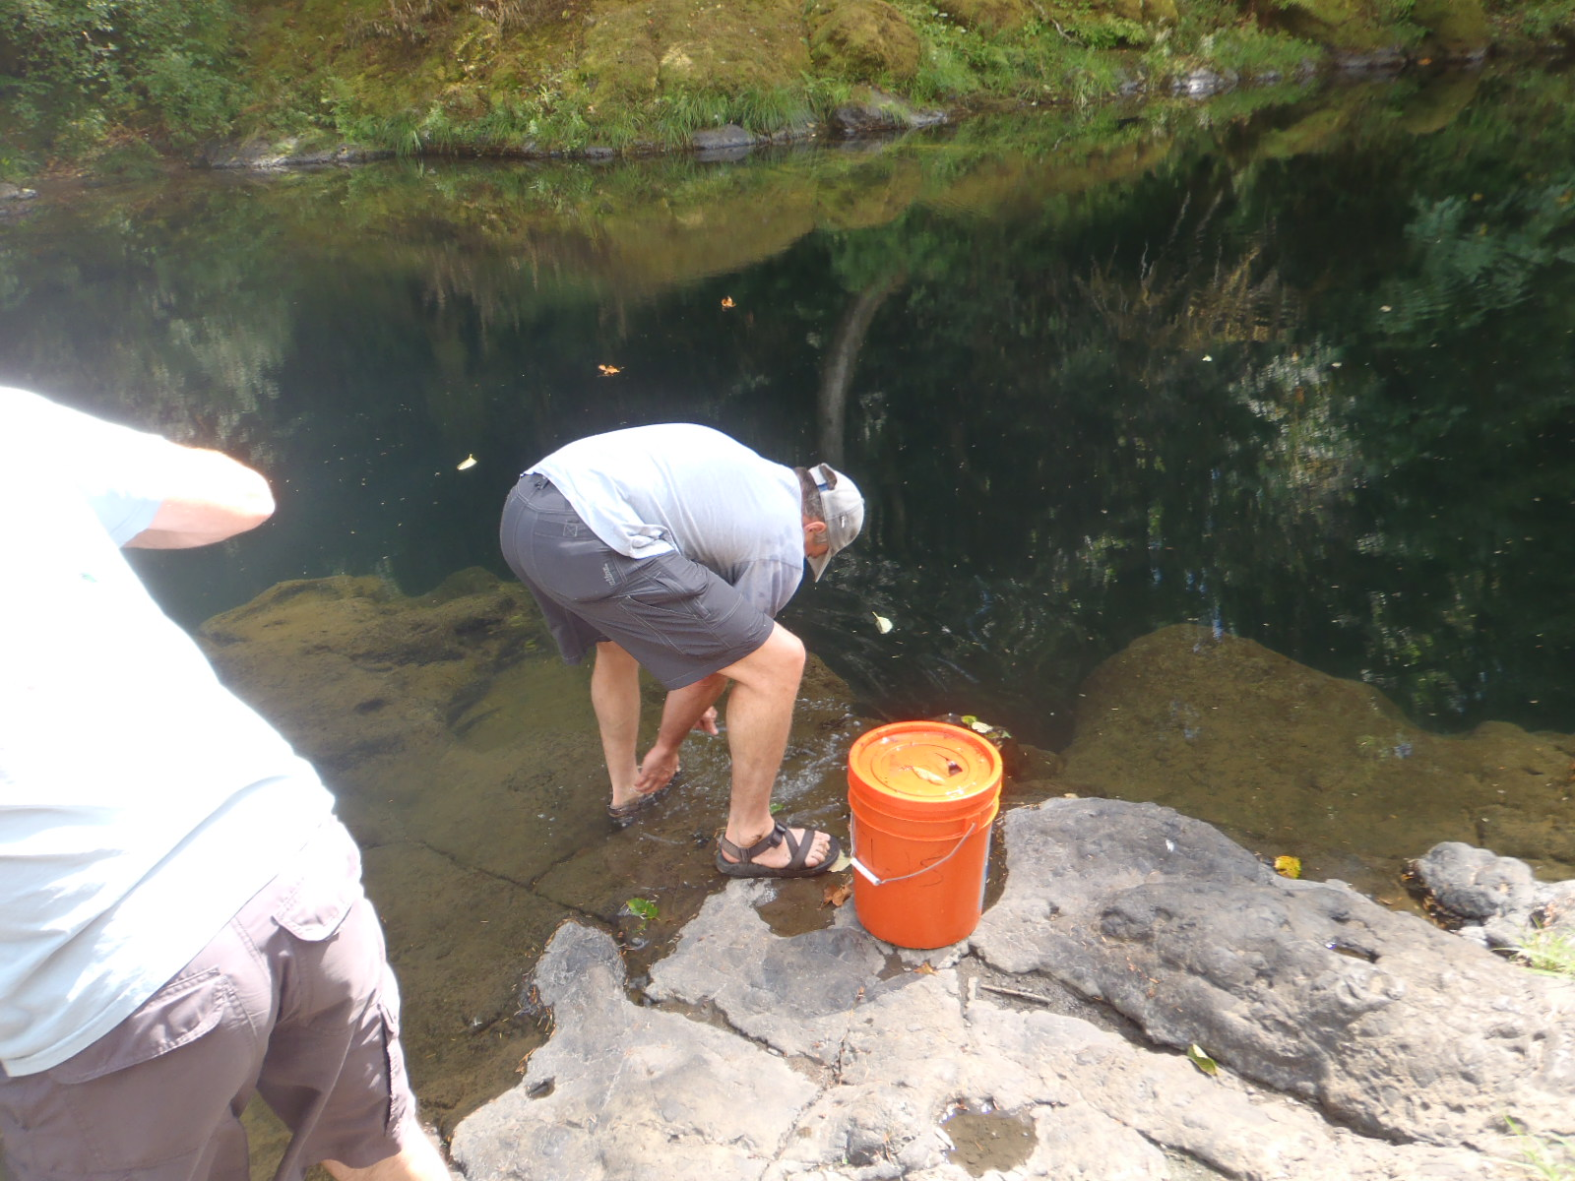
Pacific Lamprey Translocation
Confederated Tribes
of Grand Ronde
Fall Creek second drop site

Slide 27
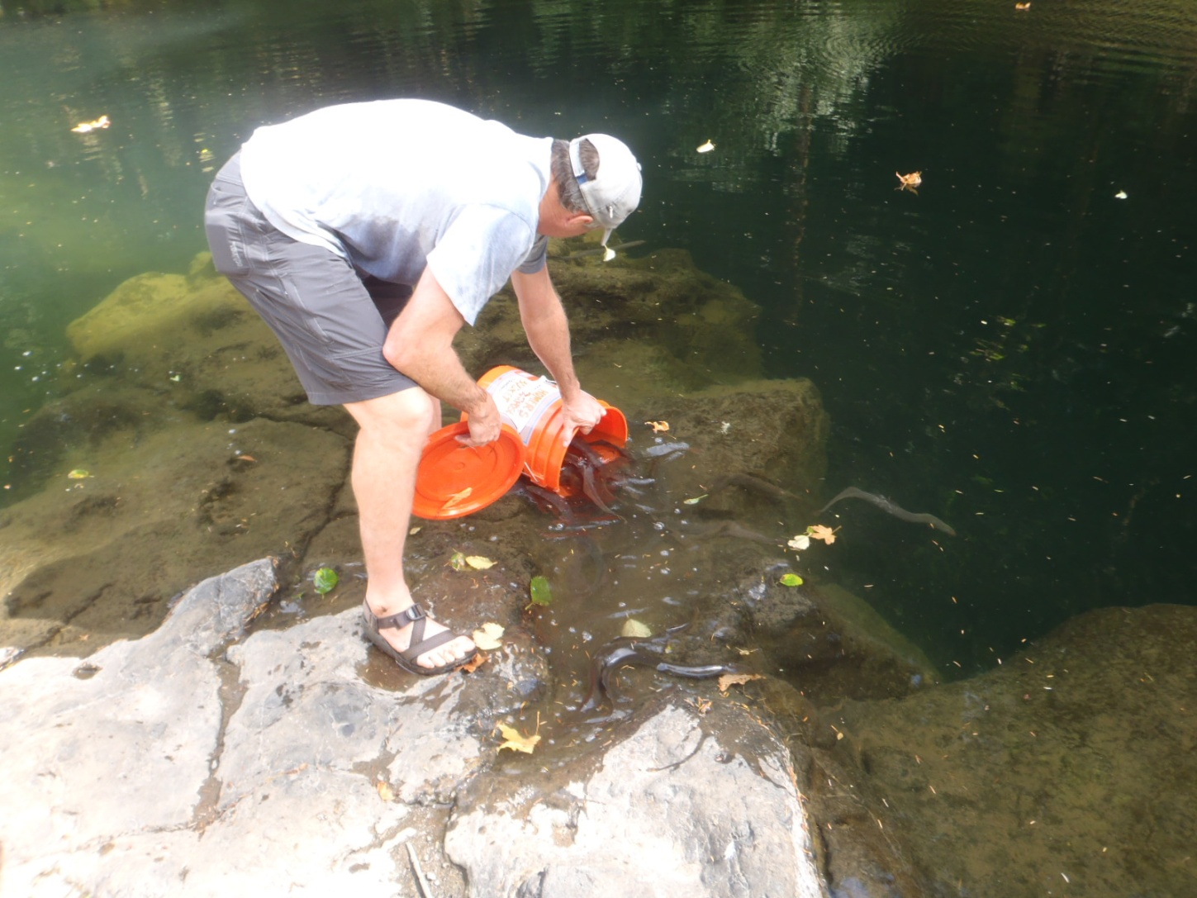
Pacific Lamprey Translocation
Confederated Tribes
of Grand Ronde
Pacific lamprey release

Slide 28
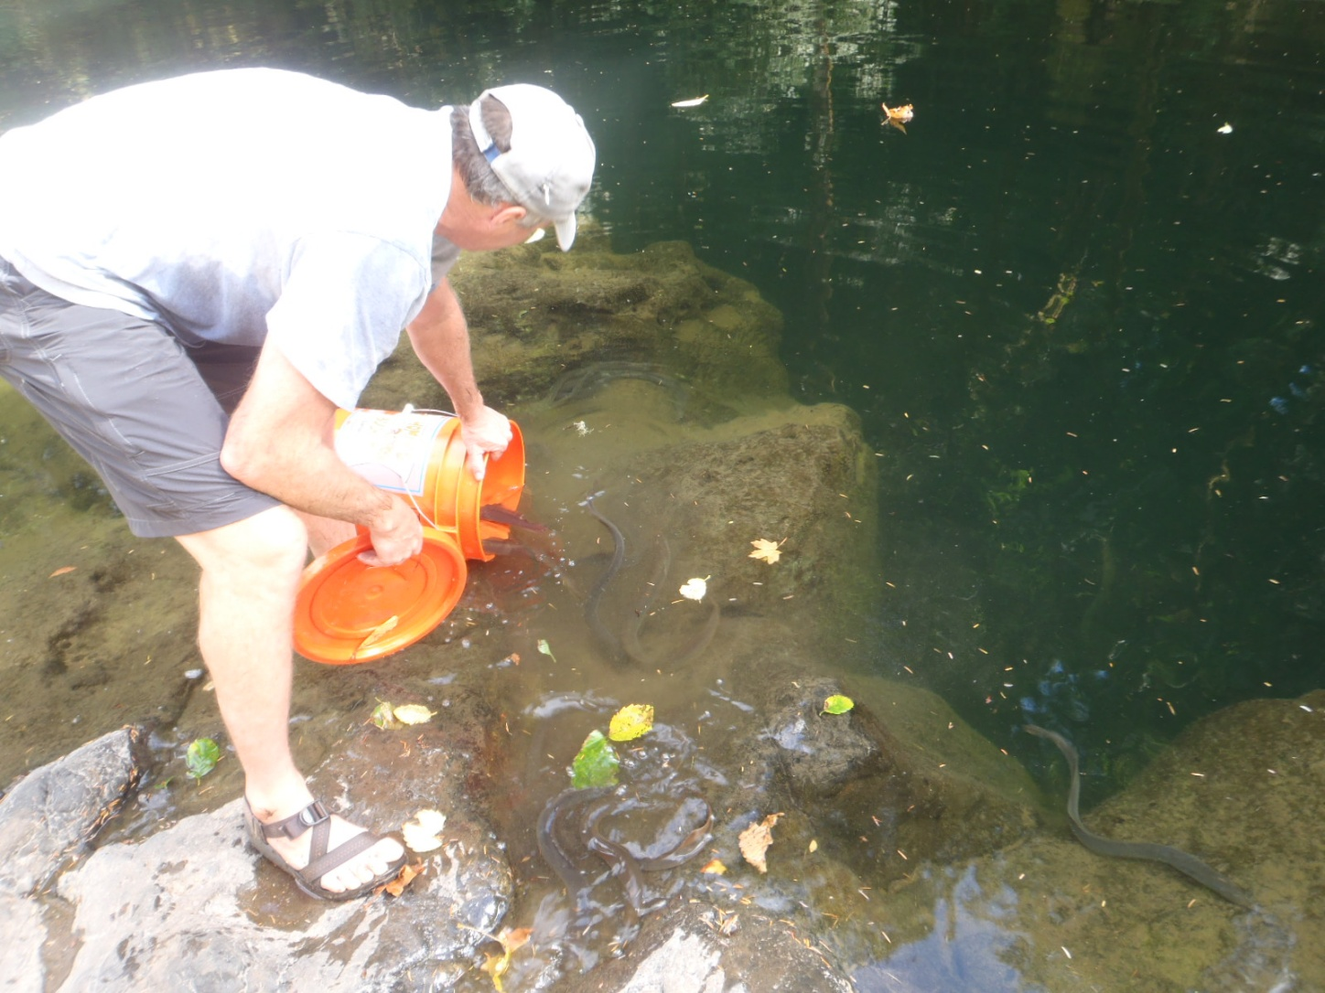
Pacific Lamprey Translocation
Confederated Tribes
of Grand Ronde
Pacific lamprey release

Slide 29
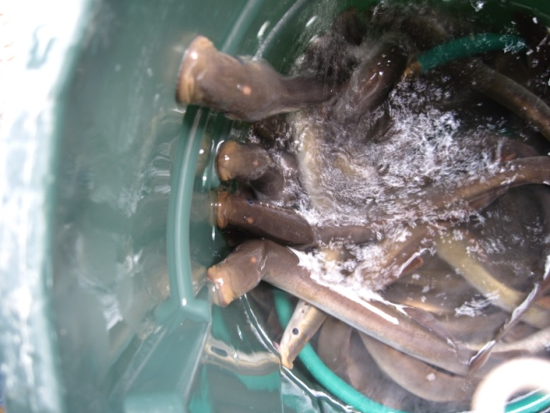
Pacific Lamprey Translocation
Confederated Tribes
of Grand Ronde
2013 Pilot Study Summary
Total 240 adults translocated
  Five separate trips
  August – September
  None marked, tagged,
  or sampled

Slide 30
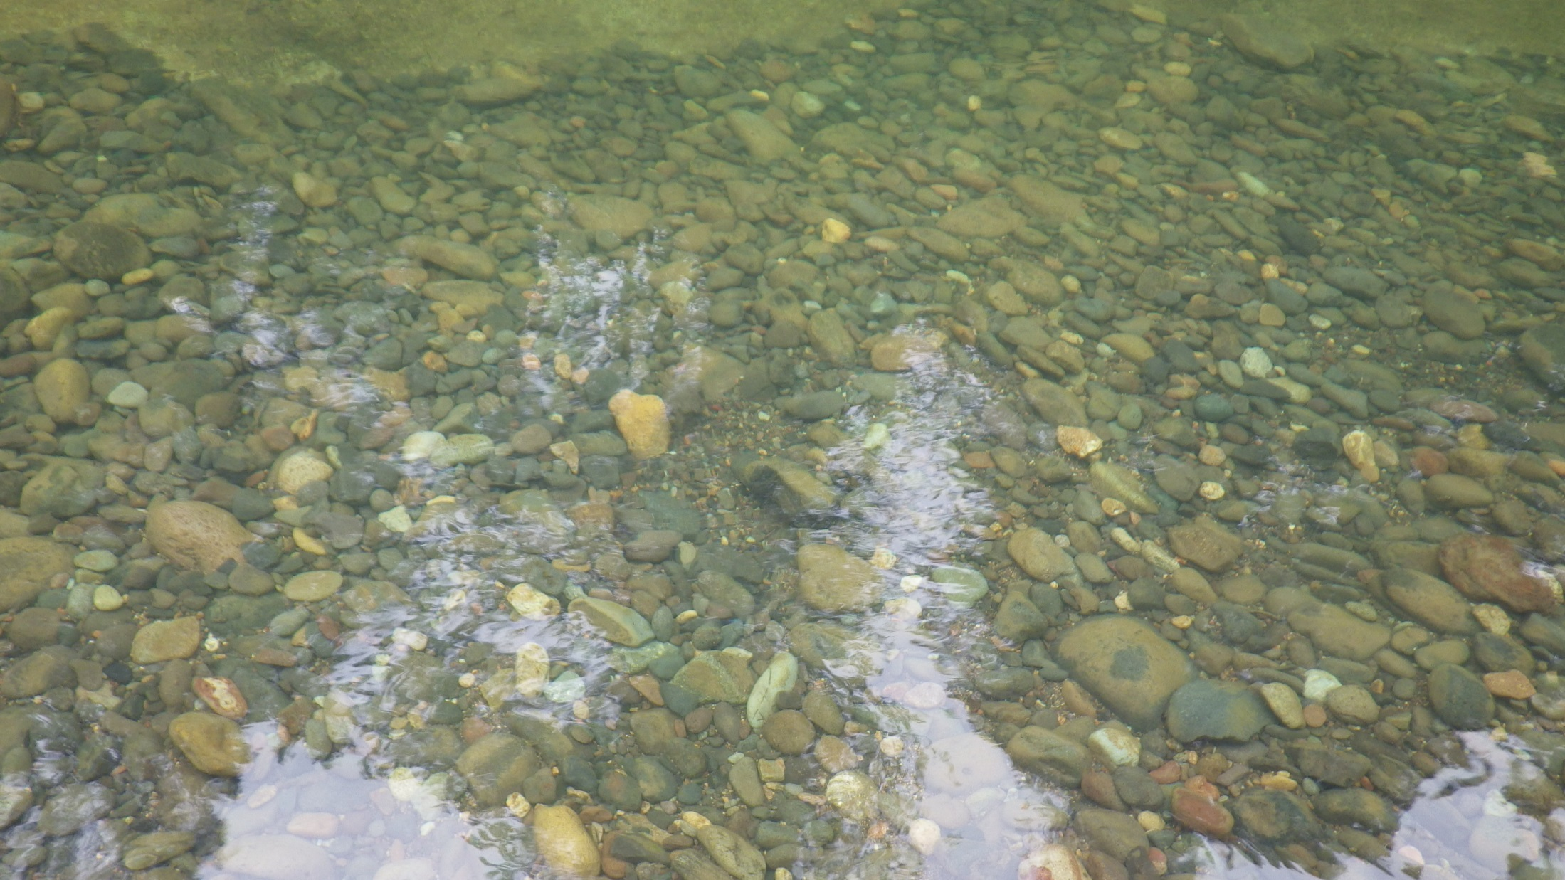
Pacific Lamprey Research
Confederated Tribes
of Grand Ronde
Notes:
Cut or move

Slide 31
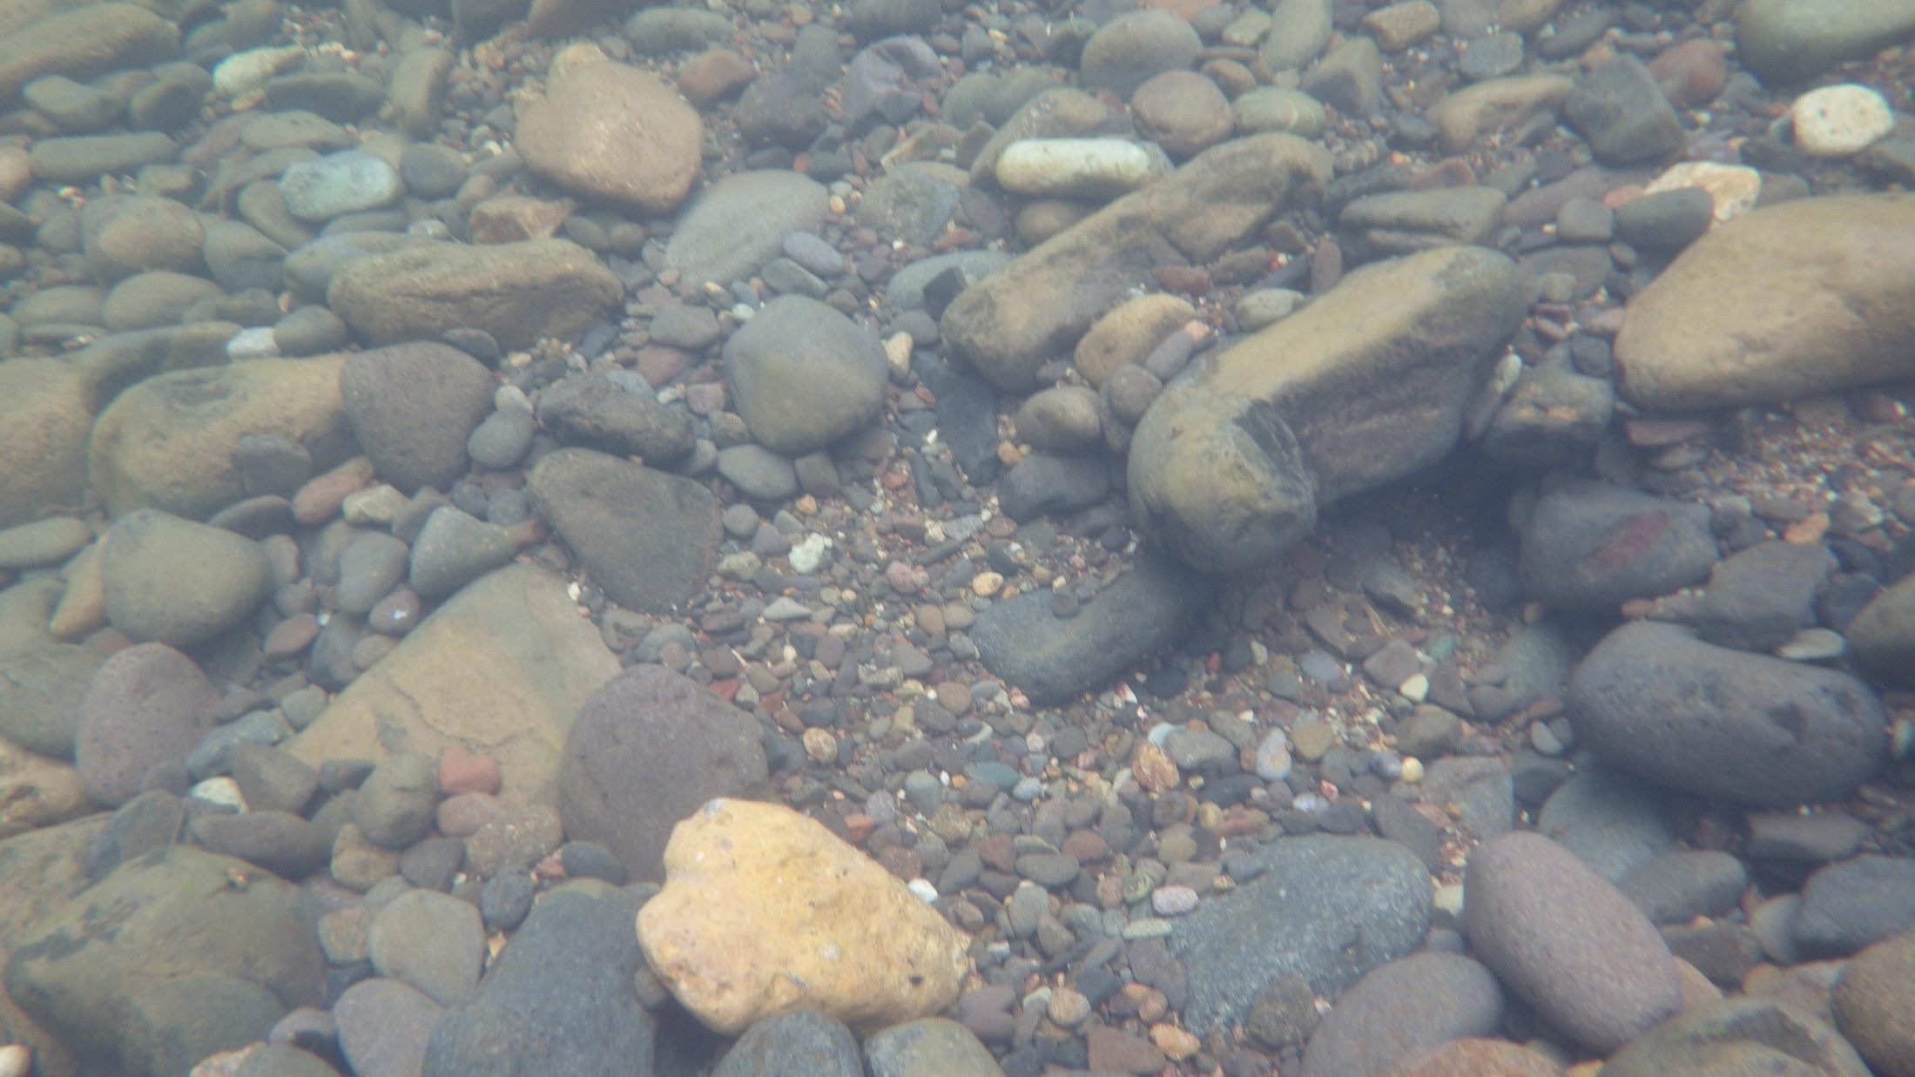
Pacific Lamprey Research
Confederated Tribes
of Grand Ronde
Notes:
Cut or move

Slide 32
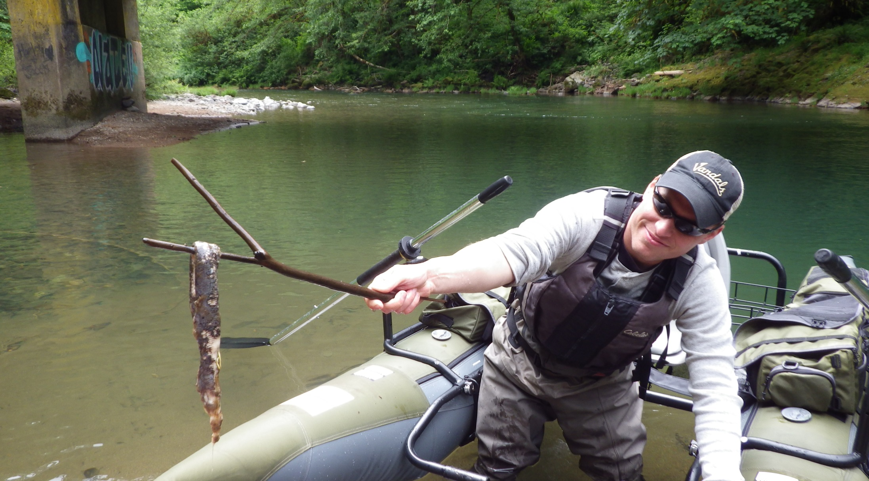
Pacific Lamprey Research
Confederated Tribes
of Grand Ronde
Notes:
Cut or move

Slide 33
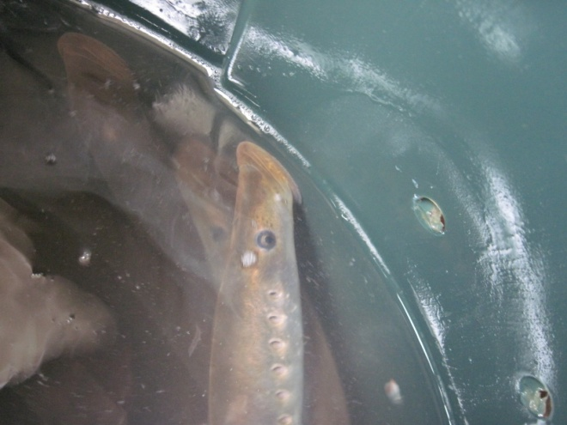
Pacific Lamprey Translocation
Future Goals/Objectives
Confederated Tribes
of Grand Ronde
2014 Transported 240
  Utilized radio-telemetry
    Implanted 40 adults
    Establish fixed telemetry receiver site at Dam
    Compliment with mobile tracking
    Pre-spawning mortality/areas of use
  Conduct spawning surveys
Full study
  One life cycle – 7 years
  Continue translocating each year

Slide 34
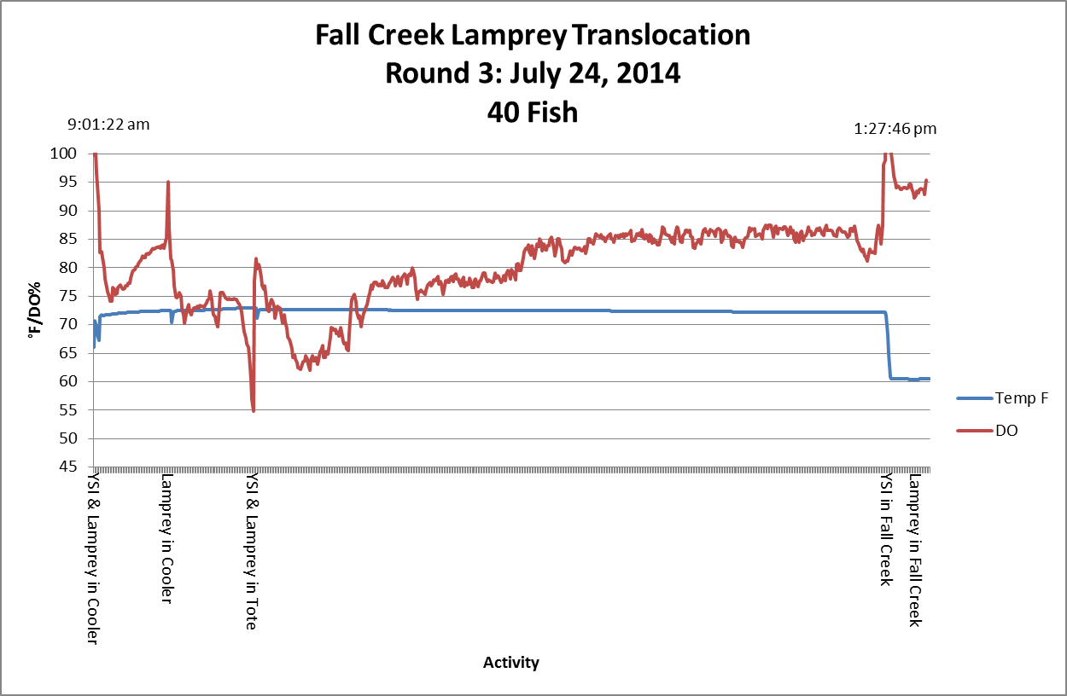
Pacific Lamprey Translocation
Confederated Tribes
of Grand Ronde

Slide 35
Pacific Lamprey Translocation
Confederated Tribes
of Grand Ronde

Slide 36
Current Distributions
Confederated Tribes
of Grand Ronde
Key
Individual
Group of 2
Group of 3
Group of 4

Slide 37
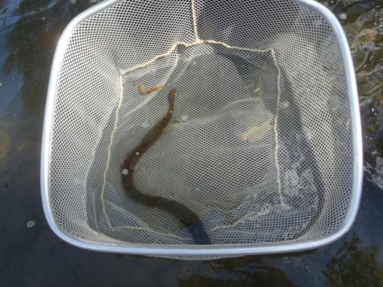
Pacific Lamprey Translocation
Future Implications
Confederated Tribes
of Grand Ronde
Fall Creek as case study
  Ideal study area
    High quality, historic spawning habitat
    Draw-down for juvenile outmigration
    Likely adults already utilize area below dam
  Passage potentially low-cost
    Minimal modifications
    Truck and haul
  Use applications elsewhere
    Other dams

Slide 38
Pacific Lamprey Translocation
Future Implications
Confederated Tribes
of Grand Ronde
Special Thanks To
Oregon State
USACE
USFWS

